Slide 1
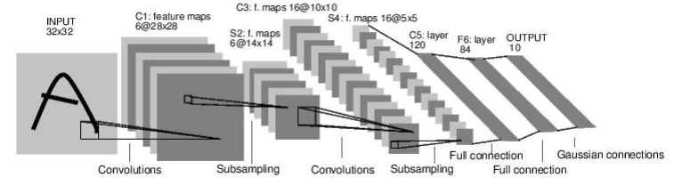
Convolutional Neural Networks

Slide 2
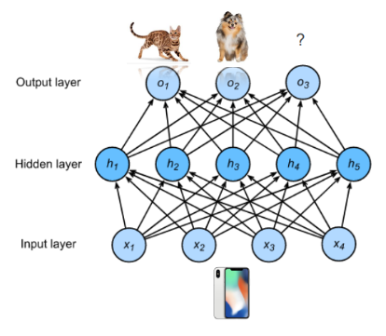
Image Classification

Slide 3
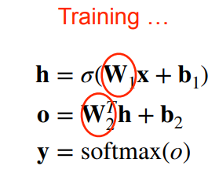
Image Classification

Slide 4
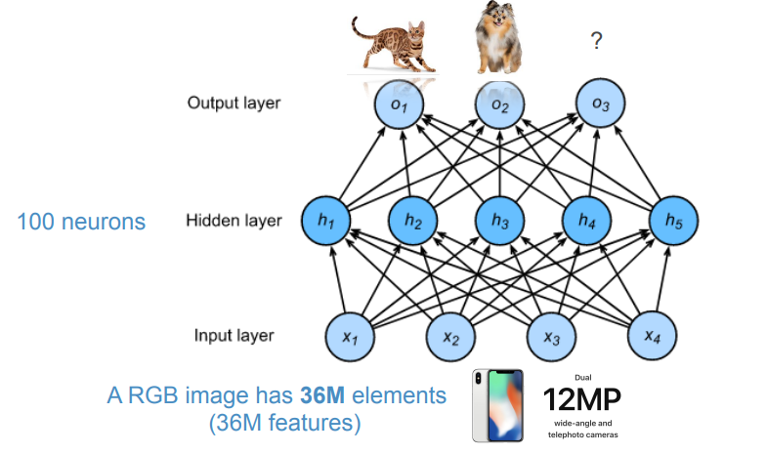
Image Classification

Slide 5
Image Classification
3.6B parameters

Slide 6
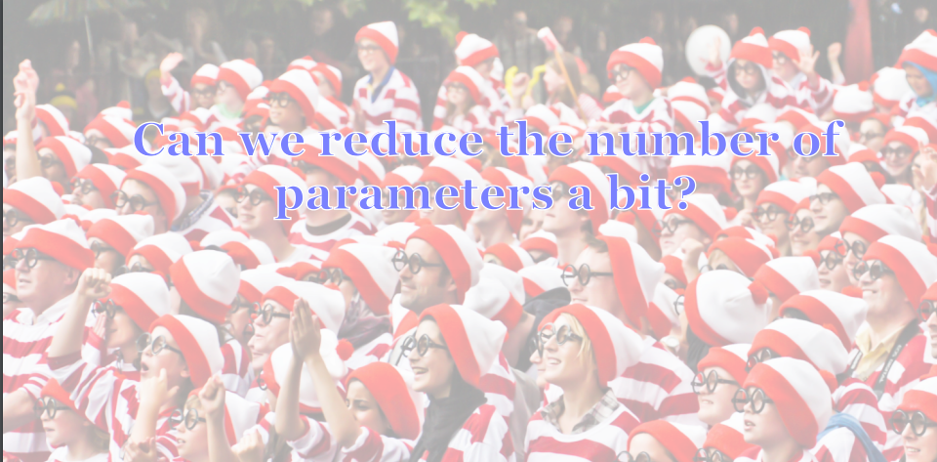

Slide 7
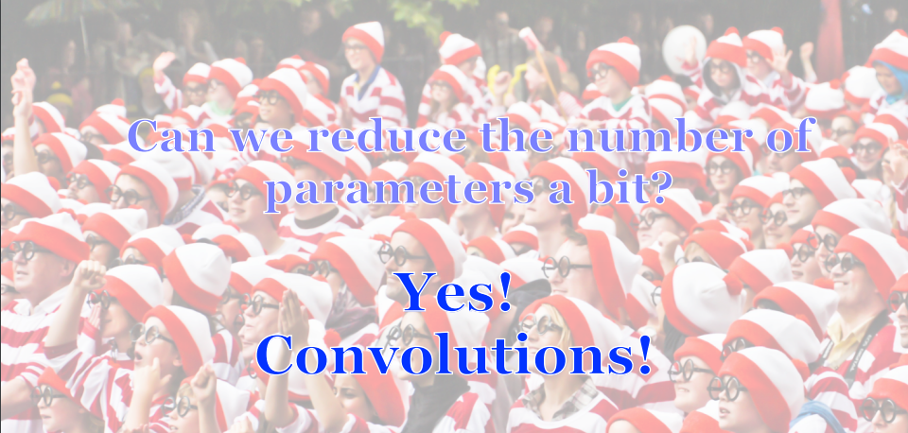

Slide 8
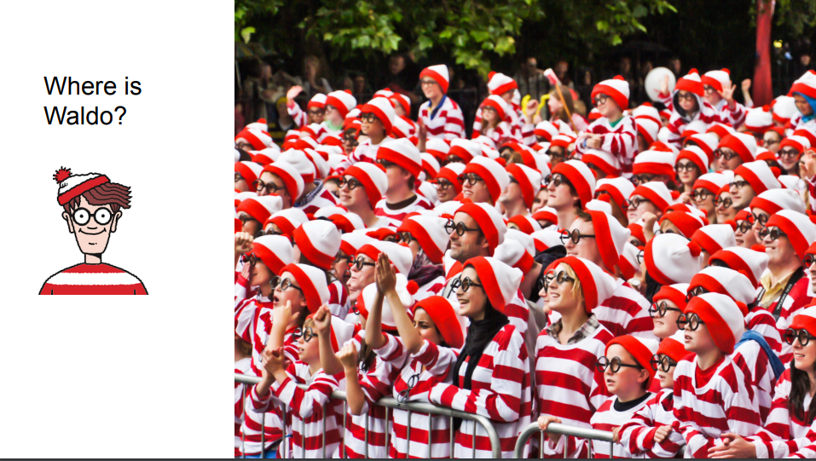

Slide 9

Two Principles
1. Translation Invariance:
Our vision systems should, in some sense, respond similarly to the same object regardless of where it appears on the image.

Slide 10
Two Principles
2. Locality:
Our visions systems should, in some sense, focus on somewhat local regions, without regard for what else is happening on the image at greater distances.

Slide 11
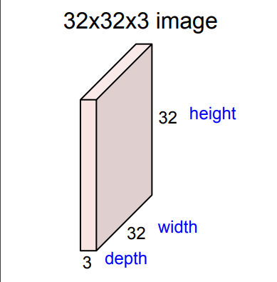
Convolution Layer

Slide 12
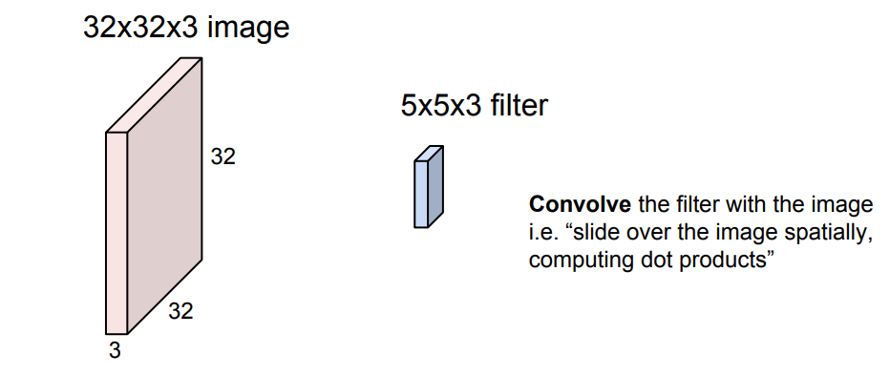
Convolution Layer

Slide 13
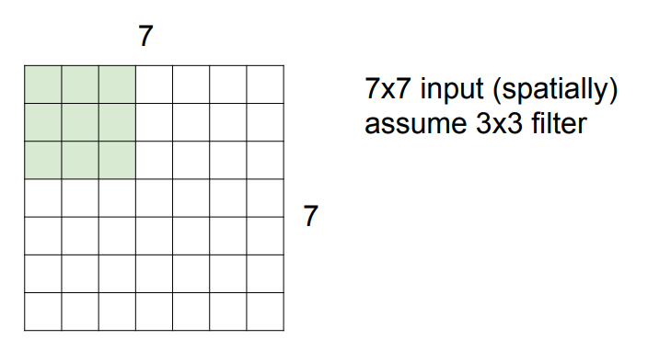
A closer look at spatial dimensions

Slide 14
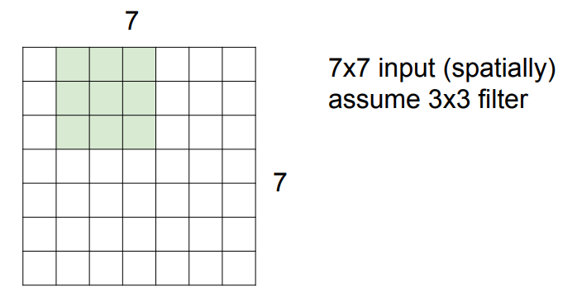
A closer look at spatial dimensions

Slide 15
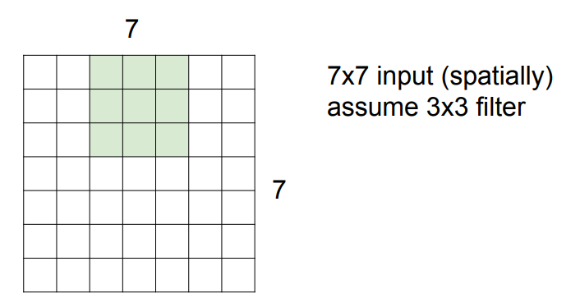
A closer look at spatial dimensions

Slide 16
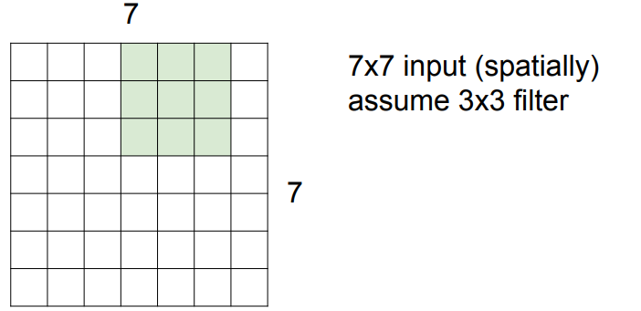
A closer look at spatial dimensions

Slide 17
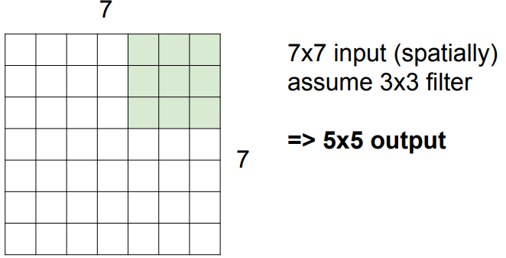
A closer look at spatial dimensions

Slide 18
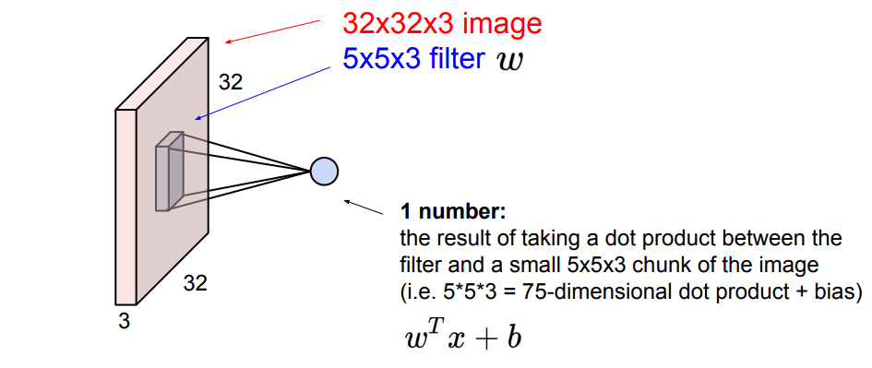
Convolution Layer

Slide 19
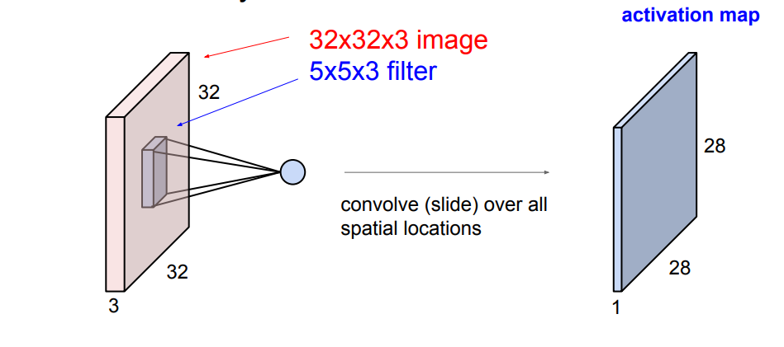
Convolution Layer

Slide 20
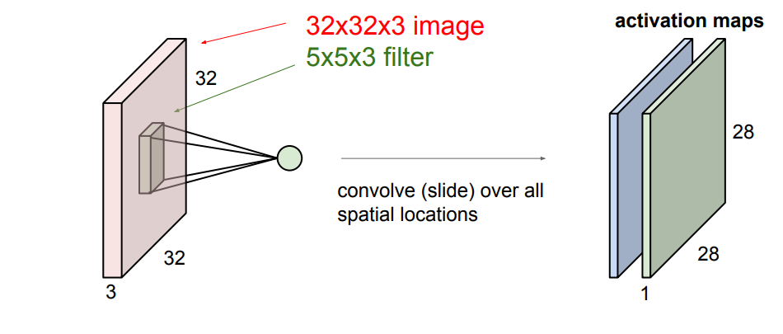
Convolution Layer
consider a second, green filter

Slide 21
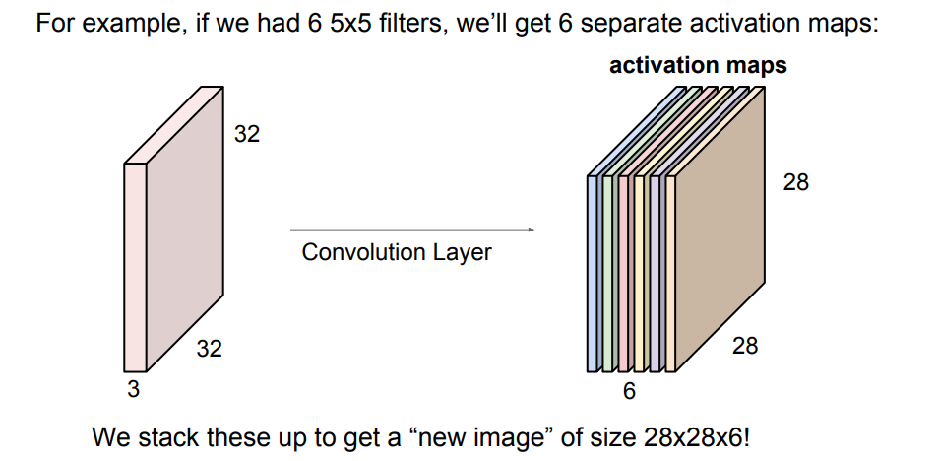

Slide 22
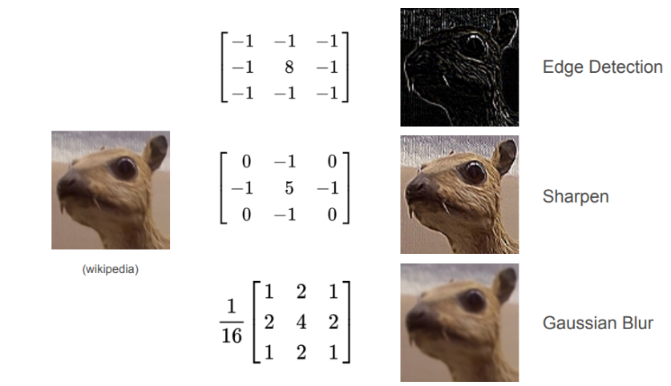
Filters

Slide 23
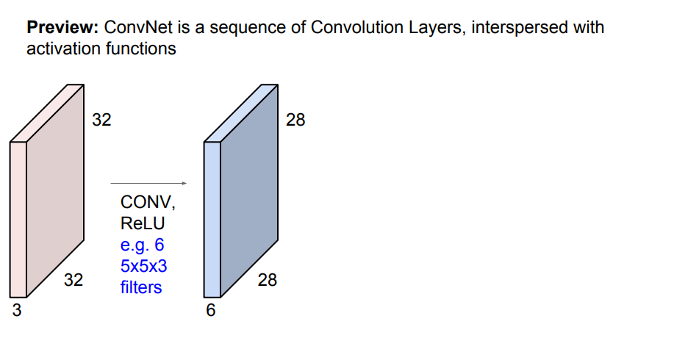

Slide 24
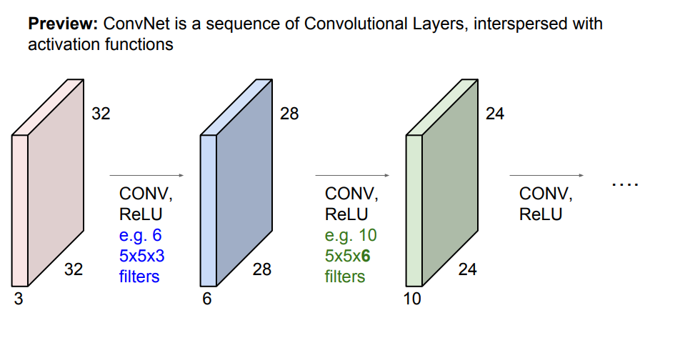

Slide 25
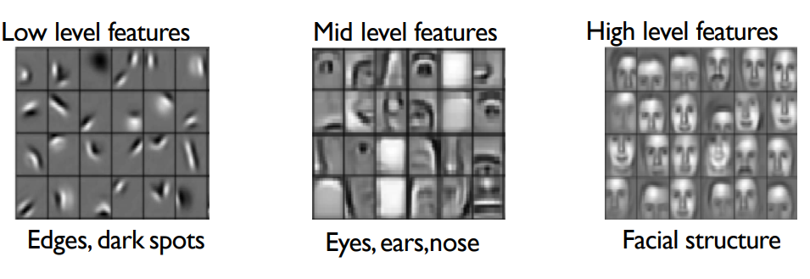

Slide 26
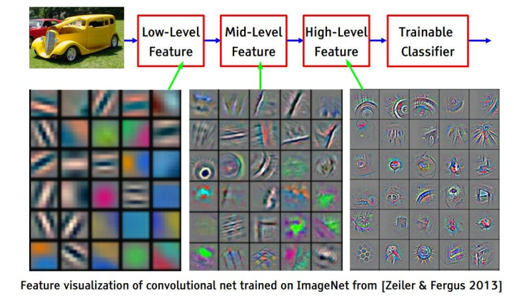

Slide 27
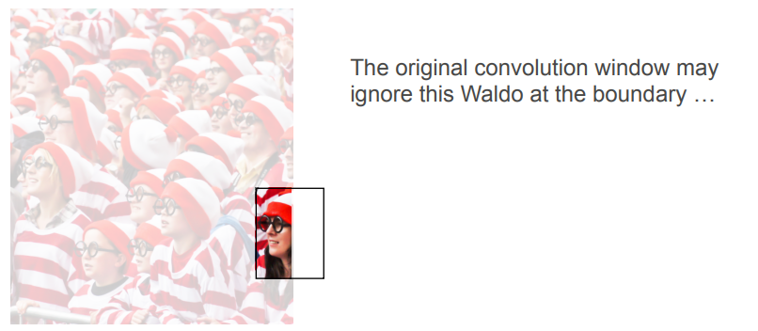
What do we do near the boundary?

Slide 28

What do we do near the boundary?

Slide 29
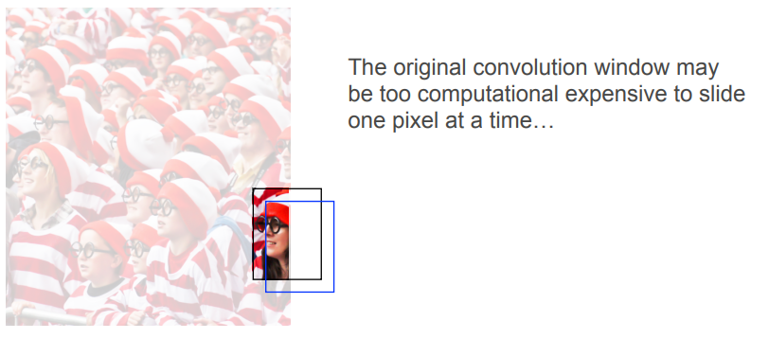
How about two nearly identical windows?

Slide 30

How about two nearly identical windows?

Slide 31
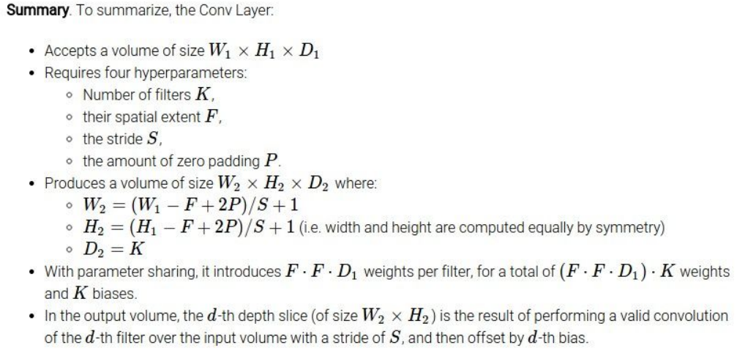

Slide 32
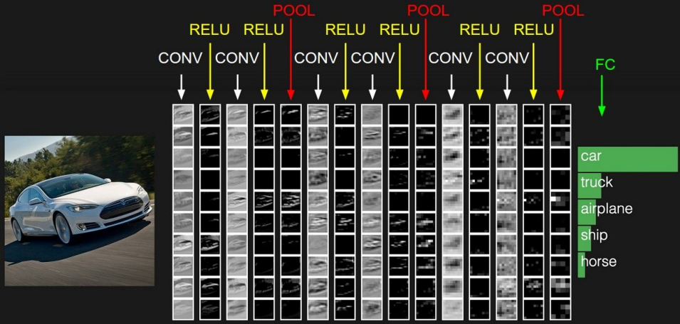

Slide 33
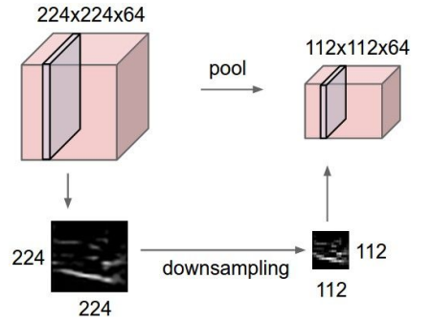
Pooling layer
Makes the representations smaller and more manageable
Operates over each activation map independently

Slide 34
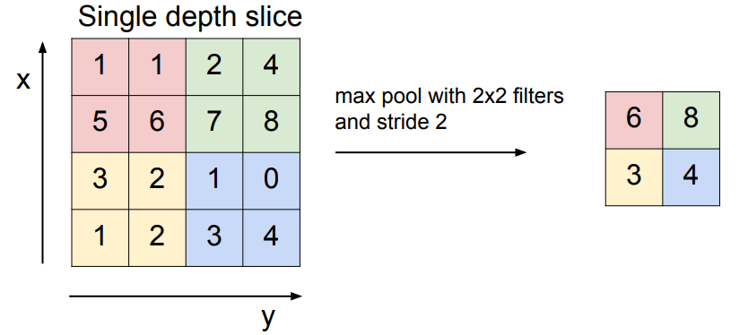
Max pooling

Slide 35
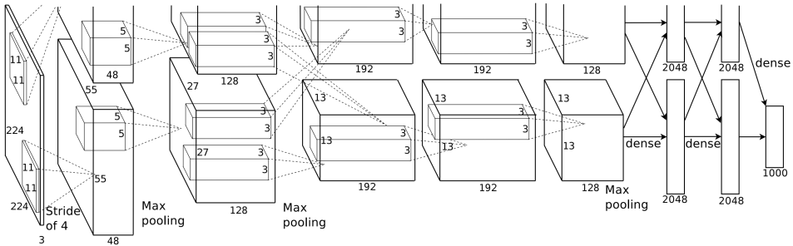
AlexNet

Slide 36
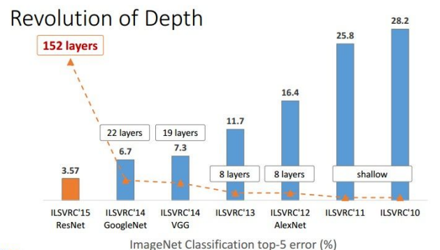

Slide 37
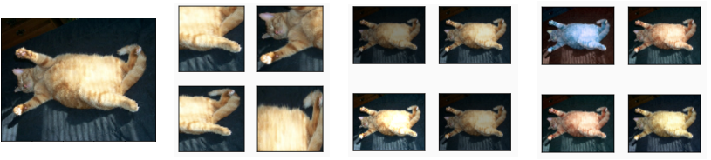
Data Augmentation

